Slide 1

2022 Annual Meeting
June 10, 2022

Slide 2

Agenda
Welcome/ Call to Order
Adoption of Annual Meeting Rules
Approval of 2021 Annual Meeting Minutes
President’s Report
Report of the Treasurer & Budget Adoption
Report of the Nominating Committee
Election
Networking
Adjourn

Slide 3
WELCOME
2022 Annual Meeting
June 10, 2022

Slide 4
ADOPTION OF ANNUAL MEETING RULES
2022 Annual Meeting
June 10, 2022

Slide 5
Annual Meeting Rules
Raise your hand if you wish to speak, state your name once acknowledged by Chair
Limit remarks to 1 min
No person will speak a second time as long as another person requests recognition to speak for first time on that issue
Confine remarks to pending question
Address the Chair and do not enter debate with audience
Chair will make every effort to alternate between supporting and opposing views
Robert’s Rules of Order, Newly Revised will govern meeting when not inconsistent with WONF bylaws
Empowering leaders of today and mentoring leaders of tomorrow

Slide 6
Annual Meeting Rules
Only current Members may vote
In accordance with bylaws, Chair will ask for Nominations from Floor when Nomination Committee Report is introduced. Should you wish to nominate yourself or anyone else for an elected position, please raise your hand to be recognized by the Chair.
  Anyone nominated must give their permission
Empowering leaders of today and mentoring leaders of tomorrow

Slide 7
APPROVAL OF 2021 ANNUAL MEETING MINUTES
2022 Annual Meeting
June 10, 2022

Slide 8
2021 ANNUAL MEETING MINUTES
WONF Foundation
2021 Annual Meeting
Friday, June 11, 2021 at 7:30 am
Online meeting hosted on Zoom
I. Call to Order
The 2021 Women Officials Network Foundation (WONF) meeting was called to order by President Nancy Philippart at 7:30 am., a quorum being present. The President announced the meeting was being recorded and that all documents to be considered were sent to members in the electronic Annual Meeting Packet. Current and retiring members of the WONF Board of Directors were introduced. The tellers, timekeeper, and parliamentarian were appointed.
II. Adoption of Annual Meeting Rules
The Annual Meeting Rules were presented and adopted without objection
III. Approval of 2020 Annual Meeting Minutes
Secretary Margaret Scott moved the adoption of the minutes of the 2020 Annual Meeting. Motion adopted via Zoom poll. As there was no objection the president appointed three members to serve as the Minutes Reading Committee: Coco Siewert, Kirsten Hartig, and Geri Rinschler to present the minutes of the Annual Meeting to members of the Board of Directors for approval.
IV. President’s Report
President Philippart presented an oral and visual report of WONF activities.
V. Report of the Treasurer
Treasurer Eileen Pulker presented the Treasurer’s Report which was filed for audit. Treasurer Pulker moved on behalf of the Finance Committee to adopt the 2021-2022 Proposed Budget. The budget was adopted via Zoom poll.
2022 Annual Meeting June 10, 2022

Slide 9
2021 ANNUAL MEETING MINUTES
WONF Foundation
2021 Annual Meeting
Friday, June 11, 2021 at 7:30 am
Online meeting hosted on Zoom
VI. Report of the Bylaws Committee
Coco Siewert moved on behalf of the Bylaws Committee to adopt the following amendments.
Amend Article IV. Board of Directors, Section 2. Number and Election by striking“up to” so that the bylaw will read The Board will consist of fifteen (15) members: nine (9) directors and six officers.
Amend Article IV. Board of Directors, Section 3. Terms of Office by inserting “Four directors shall be elected in even numbered years and five directors shall be elected in odd numbered years.”
Amend Article V. Officers. Section 1. Number and Election by inserting “in even numbered years” after meeting and by striking one year and inserting “two years” after terms.
Amend Article IV. Board of Directors, Section 3. Terms of Office by inserting a new B. “An officer or director may serve three consecutive terms and shall be entitled to serve again after a two-year period has elapsed.”
Amend Article V, Officers, Section 4. Section 4. Vice President for Program to read: The Vice President for Program shall chair the Program Committee and be responsible for planning the quarterly networking breakfast meetings and other networking events and shall chair the Training Subcommittee to provide training opportunities for women in the public arena.
Amend Section 5. Vice President for Development to read The Vice President for Development shall chair the Development Committee, and shall chair the WONder Woman Banquet Subcommittee and shall lead any other fund-raising and development activities of WON.
2022 Annual Meeting June 10, 2022

Slide 10
2021 ANNUAL MEETING MINUTES
WONF Foundation
2021 Annual Meeting
Friday, June 11, 2021 at 7:30 am
Online meeting hosted on Zoom
Amend Article VII, Nominations and Elections by striking “shall consist of three individuals who shall be appointed by the President with the approval of the Board in July of each year. Two members shall be from the Board. The chair shall have served on a previous Leadership Committee.” and inserting “the Vice President for Leadership, who will serve as chair and two members elected by the membership in odd numbered years to serve a two year term.”
Amend Article VII Committees, Section 2. Standing Committees by inserting “with the assistance of the Leadership Committee.”
Adopt the Conforming Resolution: Resolved That the secretary be authorized to correct article and section designations, punctuation, and cross references and to make such other technical and conforming changes as may be necessary to reflect the intent of the organization in connection with the adoption of any amendments.
All amendments and the Conforming Resolution were adopted via a series of Zoom polls.
VII. Report of the Nominations Committee
Leadership Vice President Deb Macon introduced Janice Berry and Cynthia von Oeyen as the other members of the Nominations Committee. The report of the Committee follows.
Two members to the Board of Directors to a two-year term expiring 2023
Honorable Theresa Rich and Nicole Wells-Stallworth. .Officers to a one-year term expiring 2022 President –
Honorable Nancy Philippart VP Program - Honorable Geri Rinschler VP Development - Layne Sakwa VP Leadership - Janice Berry - Secretary - Honorable Eleanor Siewert Treasurer - Honorable Eileen Pulker
2022 Annual Meeting June 10, 2022

Slide 11
2021 ANNUAL MEETING MINUTES
WONF Foundation
2021 Annual Meeting
Friday, June 11, 2021 at 7:30 am
Online meeting hosted on Zoom
Leadership Committee Member to a two-year term expiring 2023
Honorable Yolanda Charles
President Philippart called for Nominations from the floor. Mary Schusterbauer was nominated for the additional open position on the Leadership Committee. There were no other nominations
VIII. Elections
All nominees were elected via Zoom polls.
IX. Spotlight on Success: Special Guests and Networking
Vice President for Program Geri Rinschler introduced Dr. Jennifer Green, Superintendent Southfield Public Schools and Leigh-Anne Stafford, Director of Oakland County Health and Human Services as leaders with resilience and leadership skills. Each was invited to offer insights into experiences and lessons they have learned over the last year.
There being no further business the Annual Meeting was adjourned at 9:10 am.
The meeting was followed by a networking segment.
Eleanor Siewert, Secretary Date Approved: 7/17/21
2022 Annual Meeting June 10, 2022

Slide 12
PRESIDENT’S REPORT
2022 Annual Meeting
June 10, 2022

Slide 13


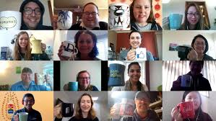

A Year in Review
Showing Up for Each Other
in support of WON’s mission to
Promote and support women leaders in the public sector

Slide 14

Focus Areas for 2021-22
Programming
Short Nuts and Bolts training
Leveraging partnerships
Implementation of Gateway to Leadership
Increasing WONF membership value
Planned mentoring initiative
Empowering leaders of today and mentoring leaders of tomorrow

Slide 15


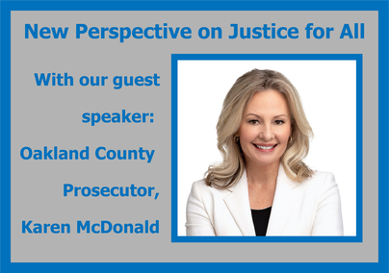
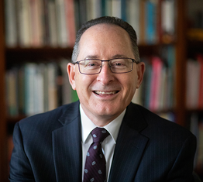
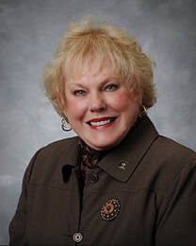
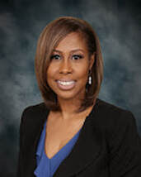
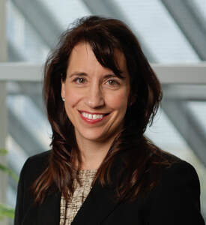
Virtual Breakfast Programs
Sept 17, 2022
March 25, 2022
Jan 21, 2022
BONUS BREAKFAST
April 29, 2022
Journey to Leadership
Dr. Embekka Roberson
Dr. Michael Rice Shirley Bryant
Empowering leaders of today and mentoring leaders of tomorrow

Slide 16




Support and Encouragement
Celebrating Courageous Women Who Ran Nov 10, 2022
Creating and Sustaining Consensus – Dec 2, 2022
Jan 6, 2022
Empowering leaders of today and mentoring leaders of tomorrow

Slide 17


Leveraging Partnerships
Collaborative Project with MWC
Michigan Appointments Database
    Goal is to increase the number of women in appointed positions, on boards and commissions
Features a match system based on select criteria
WONF will market to women
Utilized by state and local governments
Currently pitching to potential funders and database hosts
Empowering leaders of today and mentoring leaders of tomorrow

Slide 18

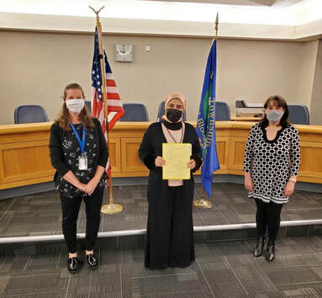
Another Way to Engage in Public Leadership
  Enables women to obtain appointed positions in various public sectors
Appointments
  State – posted with support of Michigan Women’s Commission
  Local – being assembled
Empowering leaders of today and mentoring leaders of tomorrow

Slide 19

Increased Membership Value
Offering more programs, mini trainings and celebrations
Highlighting appointment opportunities at state and local level
Leveraging our website for easier membership service
  Dues payment and renewal
  Event registration
  Giving Tuesday donations
  Communication
  Member directory
Increasing behind the scenes organizational professionalism
  Board orientation, conflict of interest statement
  Committee planning structure
Empowering leaders of today and mentoring leaders of tomorrow

Slide 20
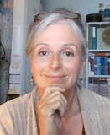
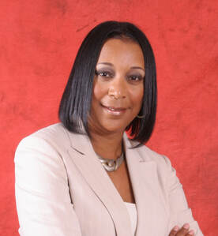
Transition to New Administrator
Monique Magee
Robin West Smith
Empowering leaders of today and mentoring leaders of tomorrow

Slide 21

Looking Ahead
Mix of in person and virtual programming to increase membership engagement
Host events at various locations throughout the tri-county area
Training to meet the needs of women in public leadership development
Continue with encouragement and celebration events
Broaden our fundraising to fund initiatives
  Gateway to Leadership
  Mentoring
Continue to enhance organizational professionalism
  Organization policy development
Provide more opportunities for member engagement
Empowering leaders of today and mentoring leaders of tomorrow

Slide 22

Looking Ahead
Empowering leaders of today and mentoring leaders of tomorrow

Slide 23

Member Engagement
Join a committee
  Development
  Leadership
  Programs and Training
  Mentoring
Join the WONF board
Invite others interested in supporting women in public leadership to join WONF, attend events
Consider applying for an appointment or running for office
Volunteer to mentor
Empowering leaders of today and mentoring leaders of tomorrow

Slide 24
TREASURER’S REPORT
BUDGET ADOPTION
2022 Annual Meeting
June 10, 2022

Slide 25
Ran a small deficit for 2021/22 due to:
  No Wonder Woman Fundraiser
  No breakfast or training revenue - board decision to not charge for virtual events
  Only partially offset by Giving Tuesday and scarf sales
  Some membership loss
Plan to run a net positive budget for 2022/23 due to:
  Hosting a successful Wonder Woman fundraiser
  Reinstating paid face to face breakfasts and other events
  Continuing to promote Giving Tuesday
  Securing grants for G2L
Empowering leaders of today and mentoring leaders of tomorrow

Slide 26
NOMINATING COMMITTEE REPORT
2022 Annual Meeting
June 10, 2022

Slide 27
Nominating Committee Report
Submitted by: Yolanda Charles, Mary Schusterbauer, Janice Berry
Empowering leaders of today and mentoring leaders of tomorrow

Slide 28
ELECTION
2022 Annual Meeting
June 10, 2022

Slide 29
NETWORKING
2022 Annual Meeting
June 10, 2022

